Slide 1

DataDen: Introduction to APIs

Slide 2
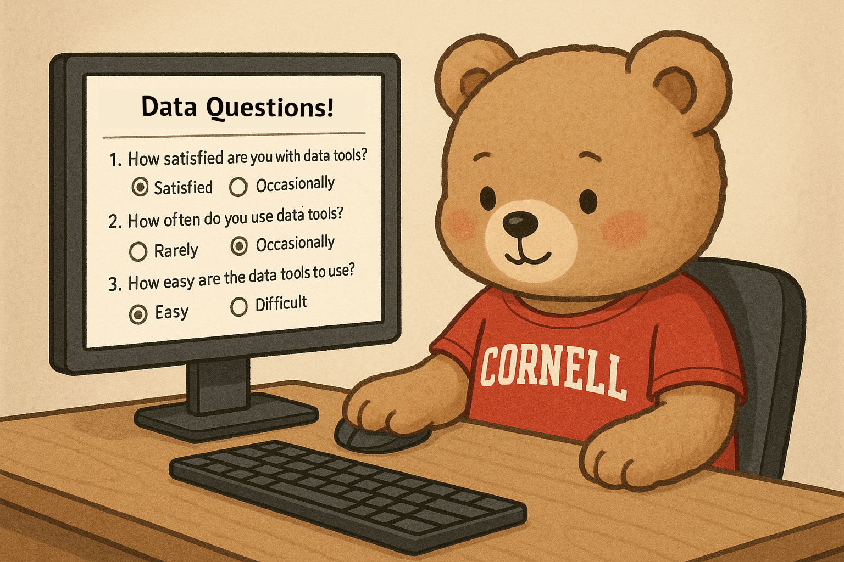
Please take this short questionnaire before we begin!
bit.ly/3JHb7xx

Slide 3
Outline
Welcome to Workshop. Introduce Instructor
What are APIs? How do they work?
Use Cases for Web Scraping and APIs. Difference between the 2
Requesting API keys (Google Custom Search API, OpenAI API)
Live Coding Demo
Evaluation Form
Additional Learning Resources
API Projects I have worked on at CCSS.

Slide 4
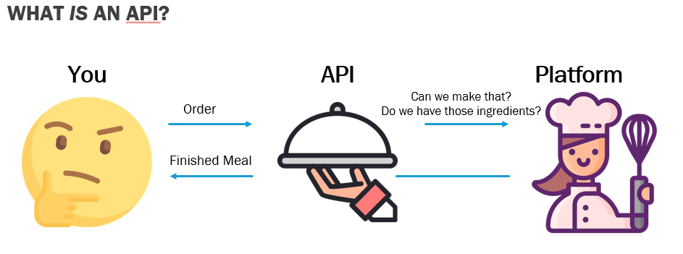
APIs
Allows communication and data exchange between 2 applications.
API Sample Data: https://jsonapi.org/examples/

Slide 5
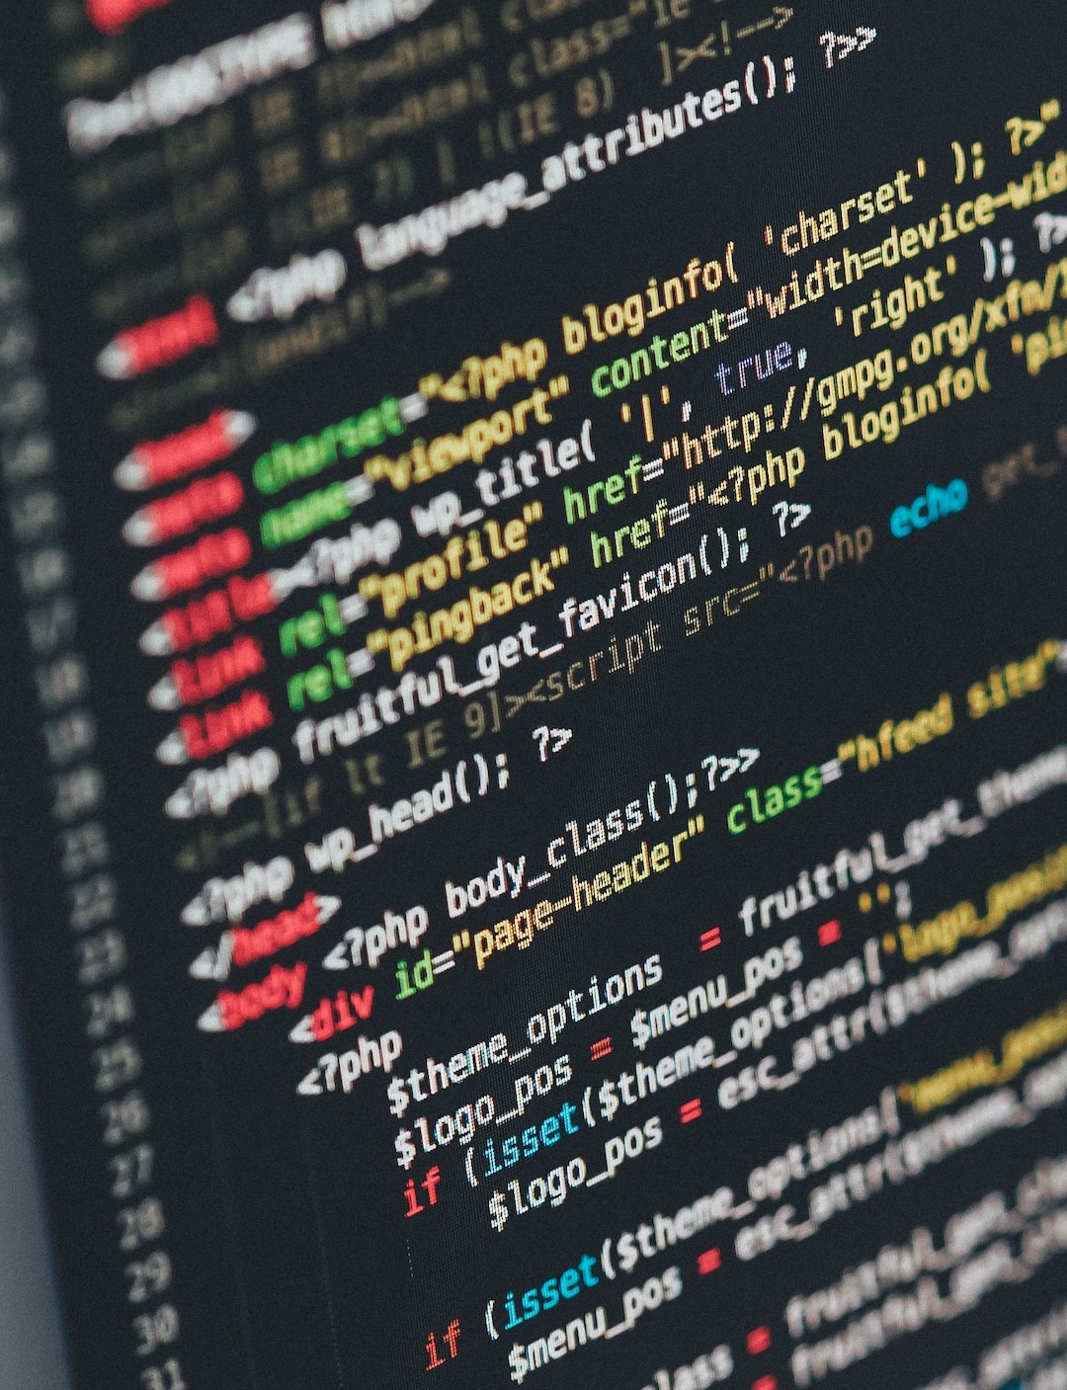

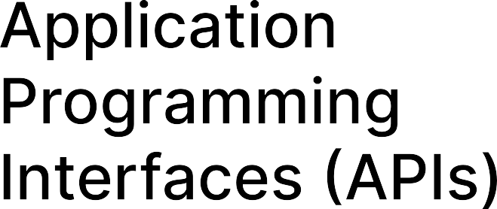
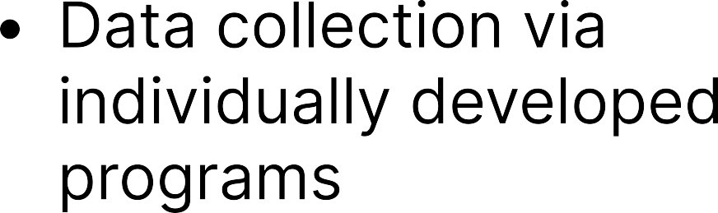

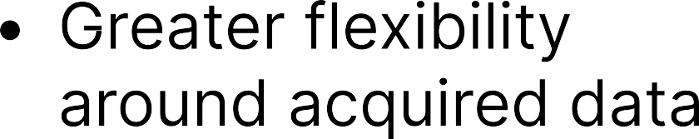




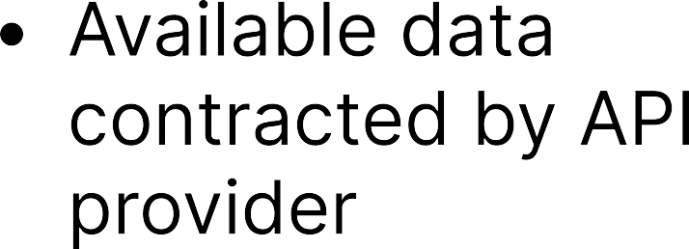
Web Scraping VS APIS

Slide 6
Coding Demo
Github Page. Sample code through Binder.
Running code through Binder

Slide 7
Please take a few seconds to give your feedback about this workshop!
bit.ly/428TL2J

Slide 8
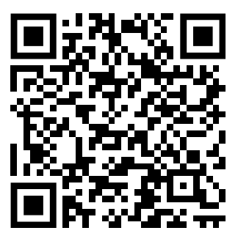
Additional Resources

Slide 9

Research Data and open Scholarship
Data and code organization, documentation, and curation
Data Management and Sharing Plans
Intellectual property rights, fair use, and authors rights
Licensing, publishing, and sharing scholarly outputs, research data, and code
Digital project management tools and electronic lab notebooks
eCommons open access repository services
Persistent identifier (i.e. ORCID, DOI) creation, management, and support
Open-scholarship@cornell.edu
Library.cornell.edu/rdos
guides.library.cornell.edu/dataden

Slide 10
